Slide 1
How To Start With PWA.
By:-
-Sai Krishna Upputuri
-Sneha Madhavaram
-Rayaan Ahmed
-Vamshi Krishna Nuka
-Srikar Patle

Slide 2





Sai Krishna Upputuri
Sneha Madhavaram
Rayaan Ahmed
Vamshi Krishna Nuka
Srikar Patle

Slide 3
Why Progressive Web Apps
Engaging
Swift
Reliable

Slide 4
Why build on progressive web apps
Worthy of being on Homescreen:
It is faster to access on the homescreen.
Increased Engagement :
With the help of push notifications the users will be able use very quickly.

Slide 5
Why build on progressive web apps
work reliably no matter the network conditions
Service worker sends very small amount of data around 63% for the intial page load and 84% less data to complete the first transcation Improved conversions.
The ability to deliver an excellent user experience AliExpress improve conversions for the new users across all browsers by 104% and iOS by 82%

Slide 6
Advantages:
Low on Data:
No Updates Required :
Sharing is Easy:

Slide 7
Advantages:
Connectivity independence. Progressive web applications can work both offline and on low-quality networks.
Full responsiveness and browser compatibility: PWAs work with all browsers and are compatible with any device, regardless of screen size and other specifications. Tablet and mobile users will have the same experience. You can even adjust the app to the desktop if needed.
Safety: These apps are served through HTTPS, so unauthorized users can’t access their content.

Slide 8
Advantages:
Push notifications. If used as a part of a good messaging strategy, push notifications can keep customers interested, motivating them to open and use an app more.

Slide 9
Disadvantages:
Poor compatibility - not working on IPhones and iPads.
PWAs can’t use some of the latest hardware advancements (like fingerprint scanner)
This is just a browser wrapper, not a fully-functional app. Technically it is still a website, and it can only do what websites can.
Full support for PWAs are not available in default browsers of some of the manufacturer's.

Slide 10
Progressive Web Applications has additional two files compared to web applications
serviceworker.js
A service worker is a script that your browser runs in the background, separate from a web page, opening the door to features that don't need a web page or user interaction. Today, we already include features like push notifications and background sync. In the future, service workers might support other things like periodic sync or geofencing. The core feature discussed in this tutorial is the ability to intercept and handle network requests, including programmatically managing a cache of responses.

Slide 11
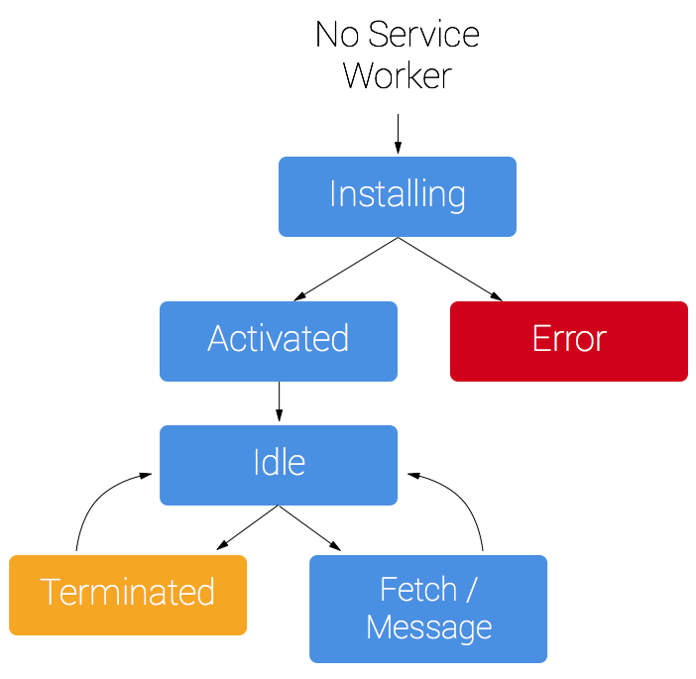
Life cycle of serviceworker

Slide 12
manifest.json
The web app manifest is a simple JSON file that tells the browser about your web application and how it should behave when 'installed' on the user's mobile device or desktop. Having a manifest is required by Chrome to show the Add to Home Screen prompt.

Slide 13
Sample code for manifest.json
{ "short_name": "Maps", "name": "Google Maps", "icons": [ { "src": "/images/icons-192.png", "type": "image/png", "sizes": "192x192" }, { "src": "/images/icons-512.png", "type": "image/png", "sizes": "512x512" } ], "start_url": "/maps/?source=pwa", "background_color": "#3367D6", "display": "standalone", "scope": "/maps/", "theme_color": "#3367D6" }

Slide 14
Working with PWA.
After creating the service worker.js and manifest.json we are ready for deploying our PWA online.
The main difference between the PWA and Non PWA applications are the above mentioned two files.
As my teammate Rayaan Ahmed explained the above described two files now here I am to do a demonstration the PWA.

Slide 15
Working with PWA
Go to the repo directory in the local machine.
Open the command prompt as administrator.
Now we can start our first PWA experience with just two commands.
npm install and npm start.

Slide 16
Working with PWA
The program contains the port address as 5000.
Now open the web browser and go to the localhost/5000.
Our designed webpage will be opened.
Now we can stop our server.

Slide 17
Working with PWA
After the server is stopped if we reload the page with non PWA the page doesn’t load.
As our page is PWA enabled we can reload the page and find the contents of the page offline too.

Slide 18
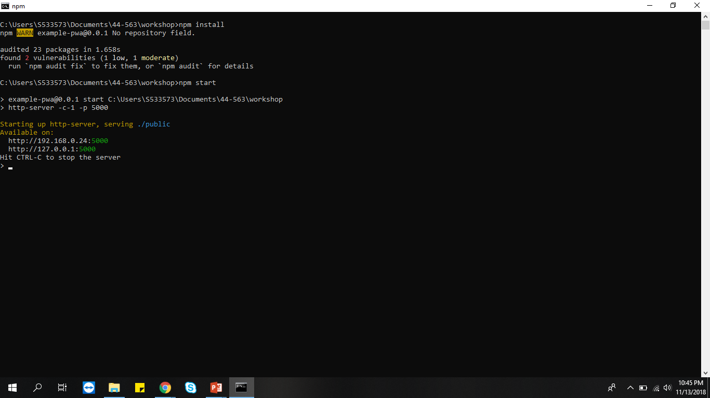

Slide 19
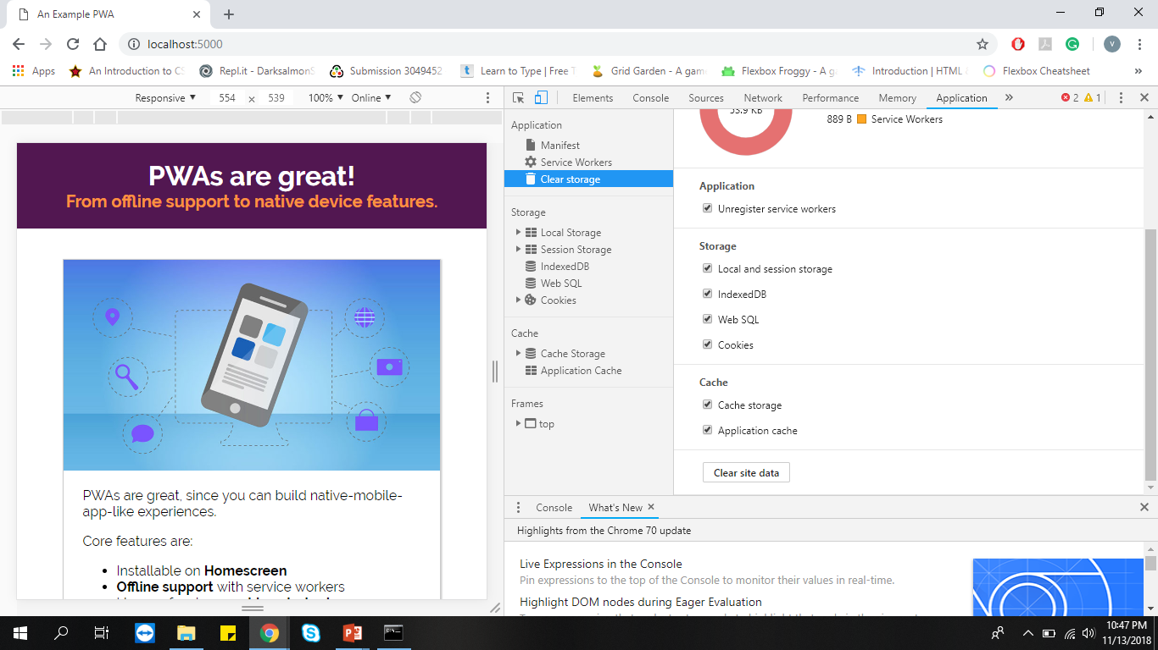

Slide 20
Conclusion
How many of you know and used a Twitter for tweets?
With over 80% of users on mobile, Twitter wanted their mobile web experience to be faster, more reliable, and more engaging.
To achieve this Twitter has launched its Twitter Lite Progressive Web App.

Slide 21
Conclusion
As stated in https://developers.google.com/web/showcase/2017/twitter
After the lite app the statistics were as follows
65% increase in pages per session
75% increase in Tweets sent
20% decrease in bounce rate
Twitter Lite is now the fastest, least expensive, and most reliable way to use Twitter.

Slide 22
Conclusion
Progressive Web App is the future of web development without any doubt.
In the future, e-commerce sites, restaurants, and media sources will transition from native app to Progressive Web App.
However, still in the initial phase, many of the developers would be actively looking for ways to make most out of the opportunities given by PWAs.

Slide 23
References:
https://developers.google.com/web/fundamentals/primers/service-workers/#the_service_worker_life_cycle
https://developers.google.com/web/fundamentals/web-app-manifest/
https://wikipedia.comhttps://developers.google.com/web/showcase/2017/twitter

Slide 24
QUERIES?

Slide 25
Thank You!!

